Slide 1

Introducing Fruit.AI: A React and Django Website
Fruit.AI is a comprehensive website designed to empower individuals to make healthier lifestyle choices through the power of fruits. Built with React and Django, it offers a user-friendly experience for learning about diverse fruits and their benefits.

Slide 2
Home Page: Showcasing Fruits and Their Health Benefits
Fruit Spotlight
Interactive Gallery
Personalized Recommendations
The homepage features a curated selection of popular fruits, each with a dedicated section highlighting its nutritional profile, health benefits, and recipes.
Users can browse a vibrant gallery of fruits, each with an engaging image, short description, and link to detailed information.
Through advanced algorithms, the website offers personalized fruit recommendations based on user preferences, dietary needs, and health goals.

Slide 3
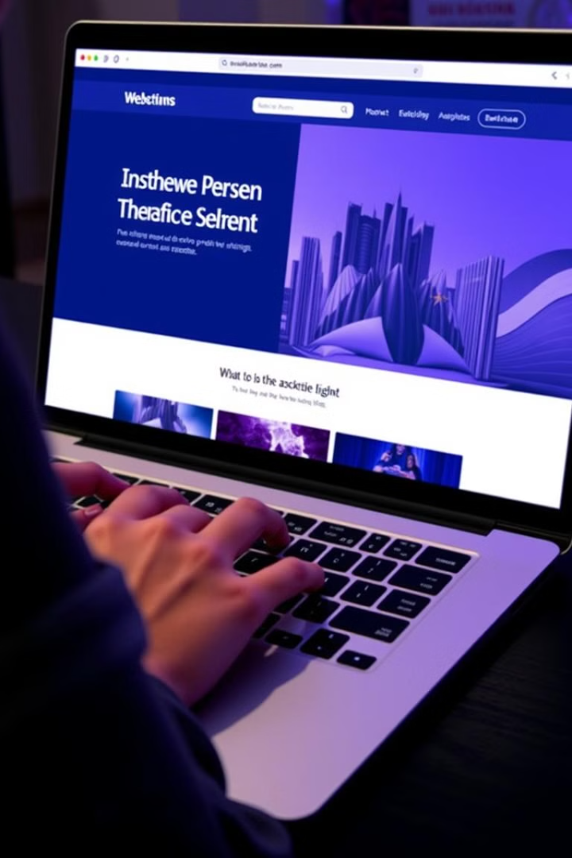
Navigating the Website: Key Features and Functionality
1
Intuitive Navigation
2
Search Functionality
A simple and intuitive navigation menu allows users to easily access different sections of the website, including the home page, fruit library, FAQ, and chatbot.
A powerful search bar enables users to quickly find information on specific fruits, health topics, or recipes.
3
User-Friendly Interface
4
Responsive Design
The website is designed with a user-friendly interface, ensuring that all users, regardless of their technical expertise, can navigate and find the information they need.
Fruit.AI is optimized for various devices, providing a seamless experience across desktops, laptops, tablets, and smartphones.

Slide 4

FAQ Page: Answering Questions about Healthy Foods
What fruits are best for weight loss?
Fruits rich in fiber, like berries and apples, can help with weight management.
Can I eat fruits every day?
Absolutely! Fruits provide essential vitamins and minerals, making them a healthy daily addition.
What are the benefits of eating fruits?
Fruits are packed with antioxidants, fiber, and vitamins, promoting overall health and well-being.
How do I incorporate more fruits into my diet?
Start by adding fruits to breakfast, snacks, and desserts. Get creative with recipes and smoothies.

Slide 5





The Chatbot: Your Personal Nutrition Assistant
Ask Anything
Personalized Guidance
The chatbot is designed to answer a wide range of questions related to healthy food choices, including fruit selection, nutrition advice, and recipe recommendations.
The chatbot provides personalized guidance based on individual dietary needs, allergies, and health goals.
24/7 Support
Continuous Learning
The chatbot is available 24/7, providing instant support and answering questions whenever they arise.
The chatbot continuously learns and improves its knowledge base through user interactions and advanced machine learning algorithms.

Slide 6
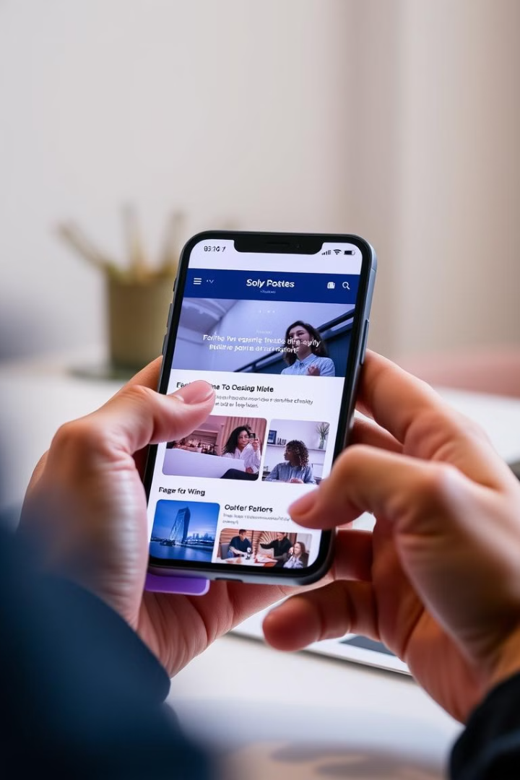



Designing for Optimal User Experience
Visual Appeal
The website features a visually appealing design, with vibrant colors, high-quality images, and an overall aesthetic that is both modern and engaging.
User-Friendly Navigation
The navigation menu is simple, intuitive, and easy to navigate, allowing users to quickly access the information they need.
Mobile Optimization
The website is optimized for mobile devices, ensuring that users can access the information they need on the go.

Slide 7

Leveraging React and Django Technologies
React
Django
The front-end is built with React, which allows for the creation of a dynamic and responsive user interface, ensuring a smooth and engaging experience.
Django provides a robust framework for the back-end, enabling efficient data management, user authentication, and secure API integration.
Integration
The seamless integration of React and Django ensures a high-performing website with a user-friendly interface and a powerful back-end.

Slide 8
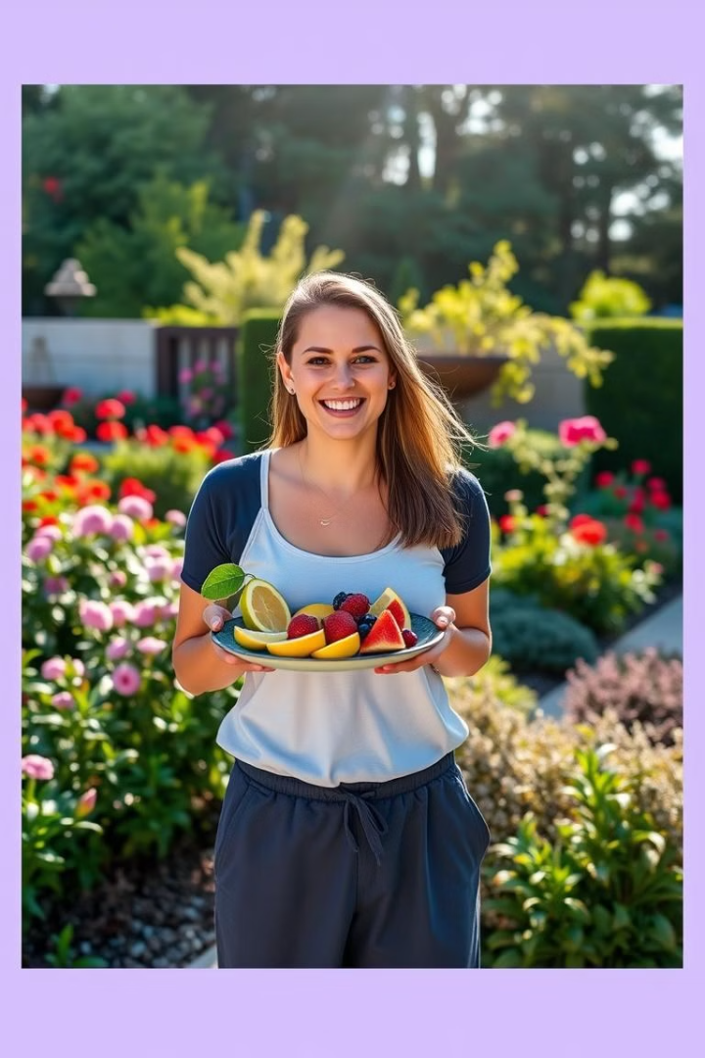
Conclusion: Empowering Healthy Lifestyles with Fruit.AI
Fruit.AI is a comprehensive platform that empowers individuals to make healthier lifestyle choices by providing access to comprehensive fruit information, personalized recommendations, and engaging educational resources. By leveraging the power of React and Django, Fruit.AI offers a seamless user experience that promotes healthy living and fosters a deeper understanding of the benefits of fruit consumption.

